Slide 1
GCCCD Technology Coordination Council (TCC)
August 18, 2017

Slide 2
Technology Plan Proposed Vision Statement
Implement student-centric, dynamic, reliable and integrated technology systems that promote student success and institutional excellence.

Slide 3
Technology Plan Proposed Guiding Principles
The Technology Plan should focus on technologies and systems which are:
Student-centered
Secure
Well integrated between systems
Sustainable with provision for appropriate support
Reliable with integrity
Supported by a robust infrastructure

Slide 4
Definition of Enterprise Resource Planning (ERP)
A software solution that integrates information and business processes to enable sharing throughout an organization of information entered once in a database.

Slide 5
ERP System Current State
 | Student Information | Registration | Financial Aid | Education Planning | Degree Audit | Human Resources | Finance | Student Outreach | Facilities Scheduling
Current System | Colleague | Colleague | Sigma | -None- | DARS | Workday | Workday | -None- | R25
Condition
Integration Potential | Colleague | Colleague | Colleague | Colleague | Colleague | Workday | Workday | Colleague | R25

Slide 6
Student Education Planning Software Demonstrations

Slide 7
Student Ed Plan Options
Hobsons-Starfish (CCTC- state initiative)
Ellucian/Colleague
EduNAV
CollegeSource

Slide 8
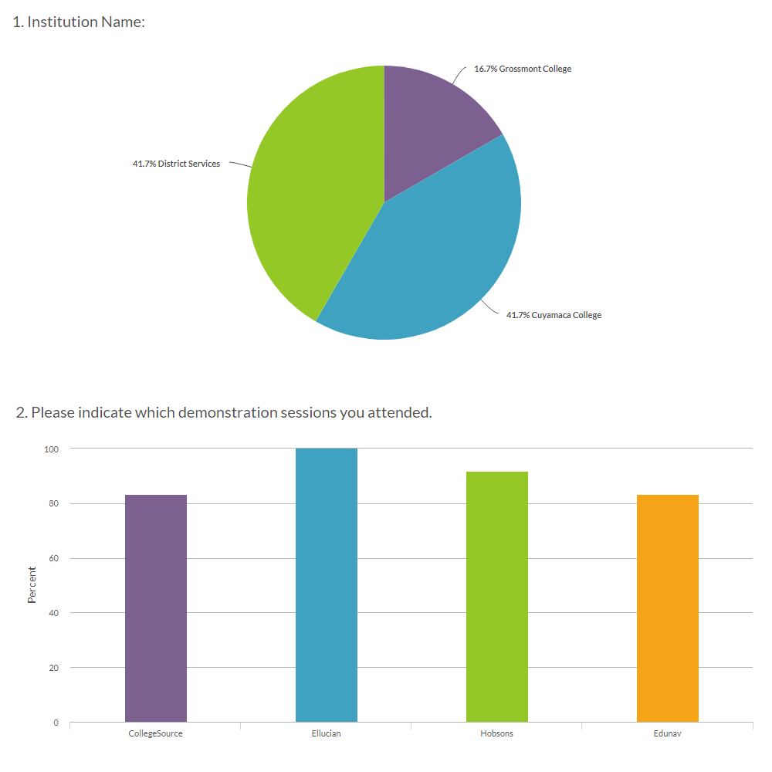
Student Ed Plan Demo Evaluations
Insert summary here

Slide 9
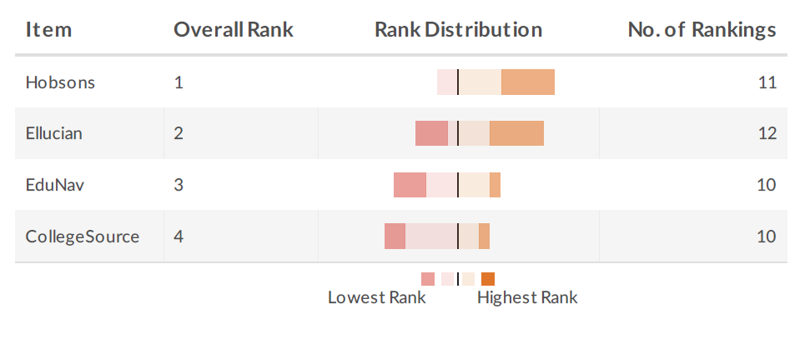
Student Ed Plan Demo Evaluations
Insert summary here

Slide 10
Student Ed Plan Hobsons-Starfish
Strengths
Already present in/have experience with CCCs (11)
Flags (early alert, to do, etc.) (8)
Low cost (3)
Weaknesses
User interface (4)
Must implement Hobson’s degree audit (2)
Very large effort to integrate with Colleague
Other factors
Does Hobson’s degree audit meet GCCCD requirements?

Slide 11
Student Ed Plan Ellucian/Colleague
Strengths
Compatibility with existing system (16)
Responsive design/accessible Via Mobile Devices (9)
Connection to Registration/Ability to Register from Plan (7)
Weaknesses
Poor user interface (8)
Other factors
Implement self-service
Consider implementing Colleague degree audit

Slide 12
Student Ed Plan EduNav
Strengths
Strong support for Ed Plan (12)
Simple/intuitive interface (4)
Alerts/warnings (3)
Weaknesses
New company/lack of track record (7)
Non-responsive design/not usable on mobile devices (5)
Accessibility/not 508 compliant (4)
High cost (3)
Other factors
“Start up” firm
Unproven integration technology with
CollegeSource degree audit
Colleague- being tested at RCCD
Foothill-DeAnza- July production

Slide 13
Student Ed Plan CollegeSource
Strengths
Degree Audit: integration with plans/compatibility (12)
Good User Interface (drag and drop, etc.) (8)
Ease of scheduling (5)
Ability to track progress (4)
Weaknesses
Confusing/complex interface (6)
Weak existing support for transfer students (4)
Other factors
Integrates with degree audit
Requires integration with Colleague for registration
CCCs in production- none

Slide 14
Alternative Strategies for ERP

Slide 15
Student/Instructional System Marketplace
Installed in California Community Colleges
Workday
Colleague (Ellucian)
Banner (Ellucian)
Oracle
Other products
CMC
Unit4
Jenzabar

Slide 16
Student/Instructional System Options
Workday Student System - implement
Colleague - do minimal
Colleague - improve

Slide 17
Student-Centered (ERP) Initiatives
Evaluate implementation of Colleague Self-Service module:
Provides better student experience
Replaces WebAdvisor
Will display additional information - student billing, etc.
Implement unused functionality available in baseline:
Graduation
Veterans module
Gainful employment
Active programs and majors
Communications management
Implement Colleague Student Ed Plan
Evaluate implementation of Colleague degree audit
Evaluate implementation of CRM/Recruit for outreach
Evaluate implementation of Colleague financial aid

Slide 18
Other ERP System Initiatives
Workday
Foundation WD Finance implementation
HR On-boarding
HR Talent management
HR Recruiter - deferred until 2018 (and finish other WD implementations)
Document imaging upgrade
R25 upgrade
Data warehouse and reporting improvements

Slide 19
Security Initiatives

Slide 20
Information & System Security
CIS 20 – Center for Internet Security 20 Controls
Current and planned initiatives
Description, Status, CIS Control, Who, Priority, Date
Information & Systems Security Workgroup

Slide 21
Security Initiatives
Implement two factor authentication
Workday-complete!
Other cloud-based systems:
Office365
Restrict administrator rights on desk top computers
Implement complex passwords
Port security issues
Physical access
Domain admins
Personally Identifiable Information (PII) protections
FERPA/PII training
Ransomware/malware protection
Firewall and subnet configuration

Slide 22
IT Infrastructure Initiatives

Slide 23
Infrastructure Initiatives
Select and implement (Voice Over IP) VOIP phone system
Upgrade wifi
Upgrade network switches
Implement Windows 10
Server/SQL upgrades

